Slide 1

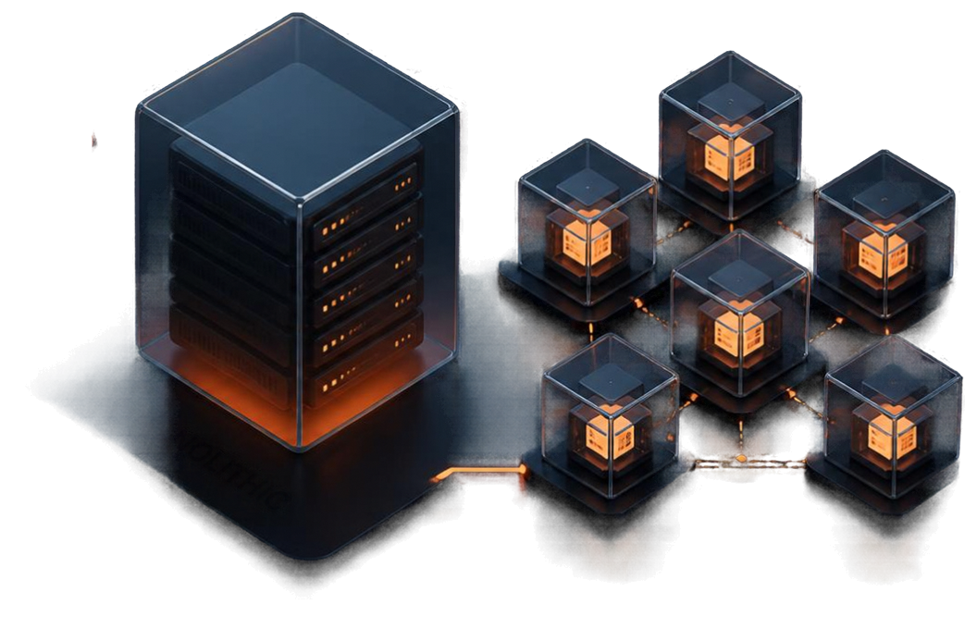
An Empirical Analysis of
Monolithic vs Microservices
Architecture
in Low Resource
Student Environment
MONOLITHIC
Nilesh
MICROSERVICES

Slide 2


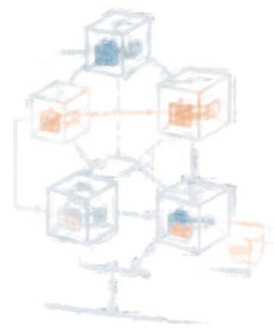





MICROSERVICES
Introduction and Motivation
MONOLITHIC
Choosing the right architecture shapes every success.
Monolithic architecture unifies everything into a single application.
Microservices architecture splits functionality into independent services.
The decision impacts maintainability, scalability, and speed.
This presentation compares both approaches to guide better architectural choices.

Slide 3

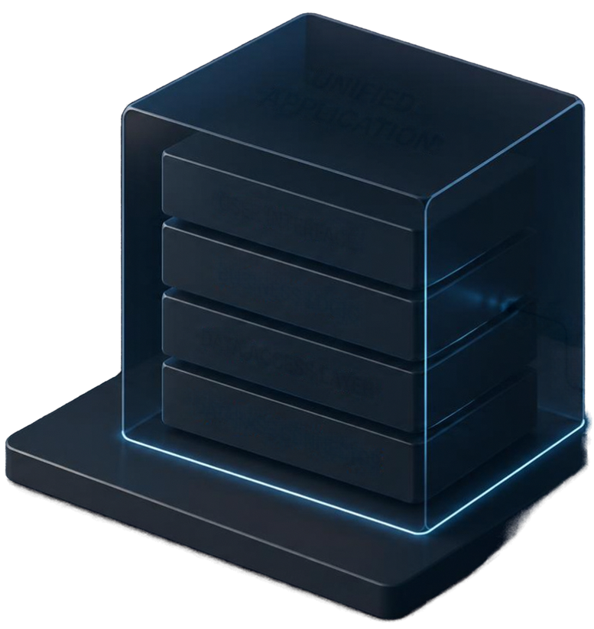
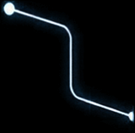

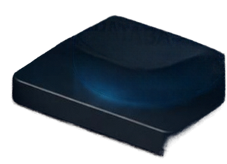
Monolithic
Architecture
Overview
UNIFIED
APPLICATION
One unified application. Everything works together.
User Interface
Business Logic
Simple to deploy
Data Access Layer
Fast in memory communication
Easier debugging
Database Connector
Database
Built as a single codebase

Slide 4




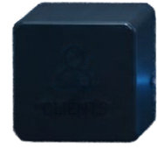























Microservices Architecture Overview
EVENT STREAM
Real-time updates via events
BUILT FOR CHANGE
API
GATEWAY
Small, independent services communicate over HTTP REST or event streams.
CLIENTS
WHY IT WORKS
Independent deployability
Fault isolation
Technology heterogeneity
USER
SERVICE
PRODUCT
SERVICE
ORDER
SERVICE
PAYMENT
SERVICE
WHAT TO MANAGE
Operational complexity
Network latency
Distributed consistency challenges
HTTP REST
EVENT STREAM

Slide 5

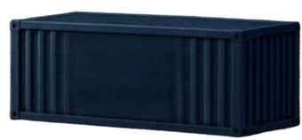


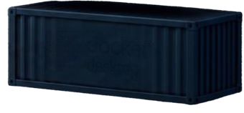

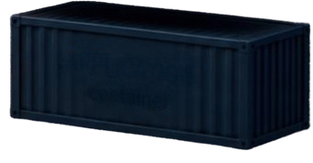
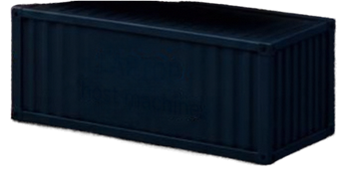


Research Context & Methodology
AUTOCANNON
load testing
docker
desktop
Students and small teams face a choice: simplicity and speed versus scalability and independence.
APPLICATION
container
We compare monolithic and microservices architectures under the same conditions.
Our objective: evaluate maintainability, scalability, and performance trade-offs.
LAPTOP
host machine
We measure what matters.
CPU
RAM
NETWORK
LATENCY
Processor utilization and load
Memory usage
and footprint
Throughput and bandwidth
Response time
under load

Slide 6









Baseline Idle Performance Metrics
Microservices consume more resources even when idle.
MEMORY FOOTPRINT
CPU USAGE
~315MB
~0.8%
~72MB
4.3x
higher
<0.1%
Monolith
Microservices
Monolith
Microservices

Slide 7
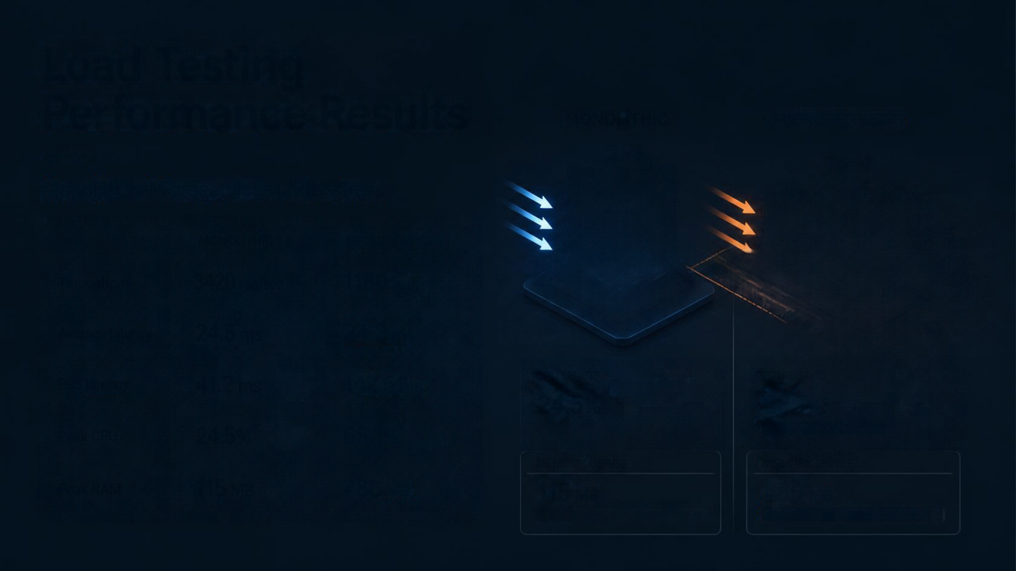


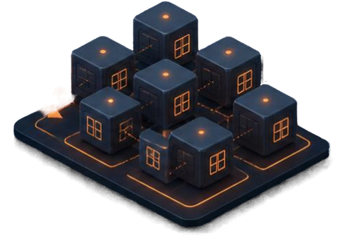







Load Testing Performance Results
MONOLITHIC
MICROSERVICES
Monolith vs Microservices under stress
MONOLITHIC
MICROSERVICES
Throughput
3420
1180
Average latency
24.5 ms
24.2
P95 latency
41.2 ms
142.6
CPU USAGE
CPU USAGE
24.5%
68.1%
Peak CPU
24.5%
68.1%
MEMORY USAGE
MEMORY USAGE
Peak RAM
115
480
115
480

Slide 8






Discussion and Practical Implications
01
Microservices introduce severe performance and resource penalties
02
Higher memory usage from duplicated runtimes and dependencies
03
Network overhead leads to latency spikes and increased CPU load
Monolithic architecture is the better fit for solo developers and student projects with hardware constraints
04

Slide 9

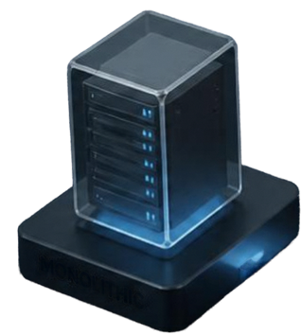
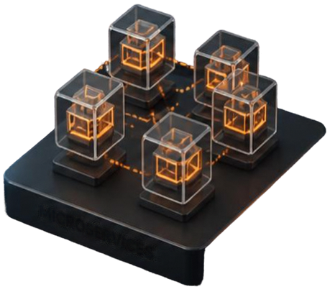



Conclusion and Future Work
Monolithic architecture delivers better performance, simplicity, and resource efficiency in constrained environments.
MONOLITHIC
gRPC
Microservices introduce complexity and overhead not ideal for
low resource environments.
MICROSERVICES
Future work will explore binary protocols like gRPC to reduce
latency and improve efficiency.
FUTURE EXPLORATION

Slide 10

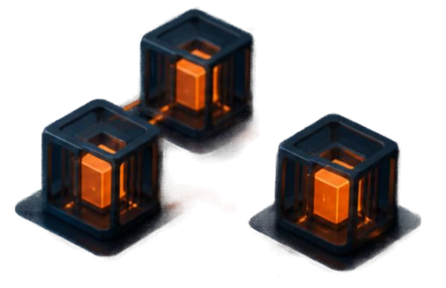
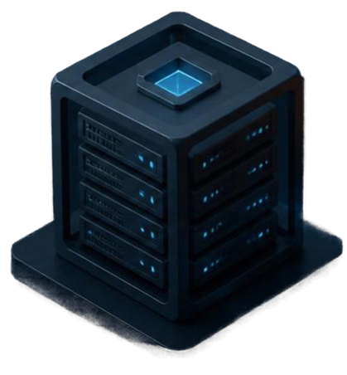
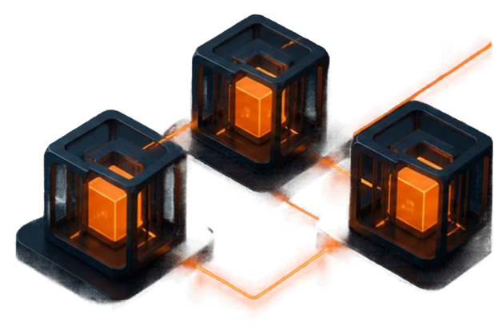
Thank You and Q&A
Thank you for your attention.
I'm happy to take your questions
and discuss any aspect in more detail.
Let's build better software, together.

